Slide 1
EVOGLE Website
(English Version)
10/18/2017

Slide 2
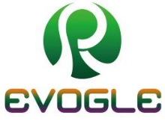




HOME (1)
Home Data Products News About Us Contact Us
EVOGLE: Air Quality Monitoring
& Solutions
包涵一个下拉菜单“Local AQ”
首页图。点击背景后进入下一页

Slide 3
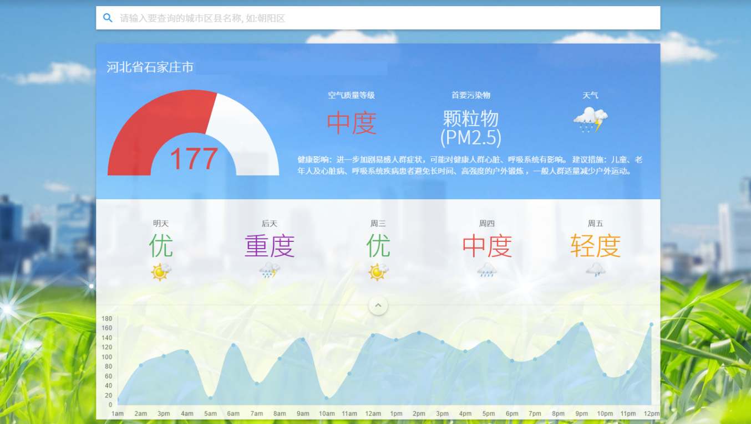
HOME (2)
Home Data Products News About Us Contact Us
EVOGLE: Air Quality Monitoring
& Solutions
点击背景第一页后，出现当地当天的天气及空气质量信息。修改背景颜色使得比较一致

Slide 4
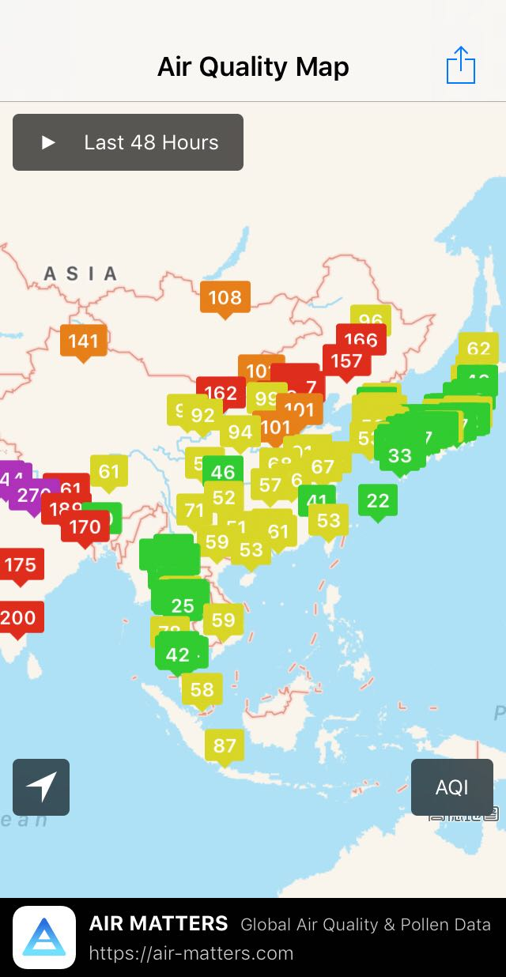
DATA (1)：Air Quality Map
包涵四个下拉菜单“Map；Data；Download；Upload”
Home Data Products News About Us Contact Us
AQI PM2.5 PM10 PM1 SO2 NO2 CO O3 Temp
Air Quality Map
可以选择展示不同数据
方框用来展示国家的数据；圆圈用来展示自己后来添加的数据
颜色显示不同污染程度
点击每个数字后进入下一页

Slide 5
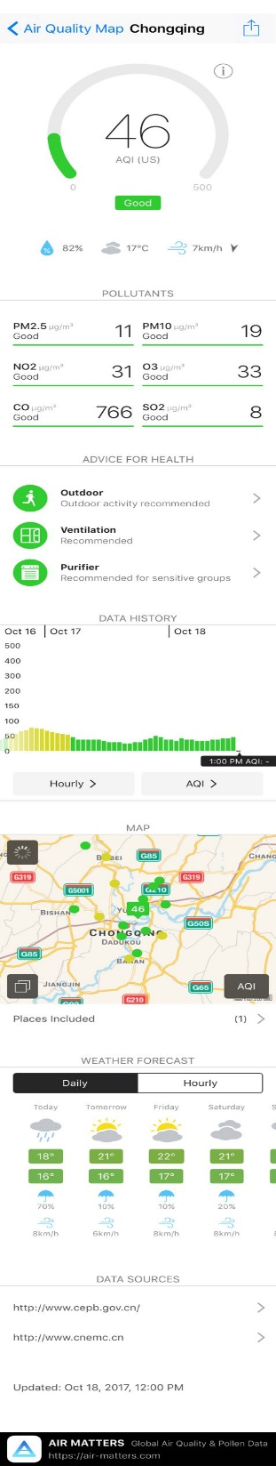
DATA (2)：Local Air Quality
Home Data Products News About Us Contact Us
详细展示所选地方的信息；需要重新进行排版
需要在最后提供一个：DOWNLOAD的按钮，提供数据下载服务

Slide 6
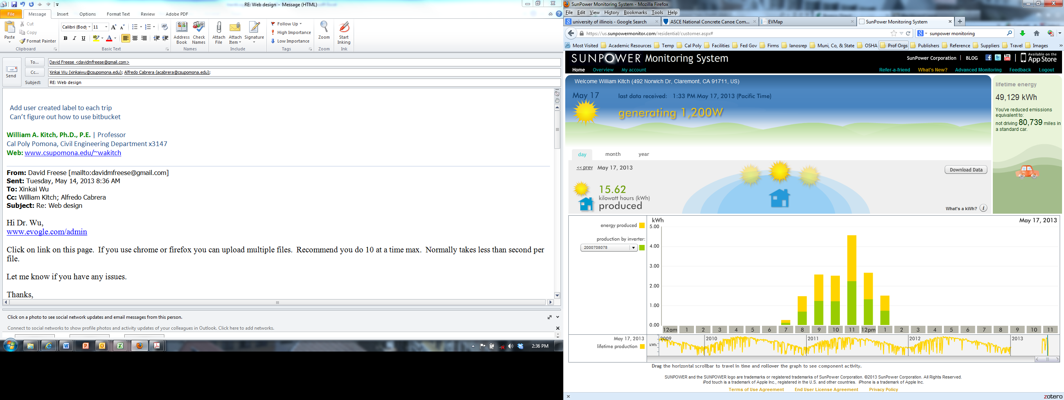
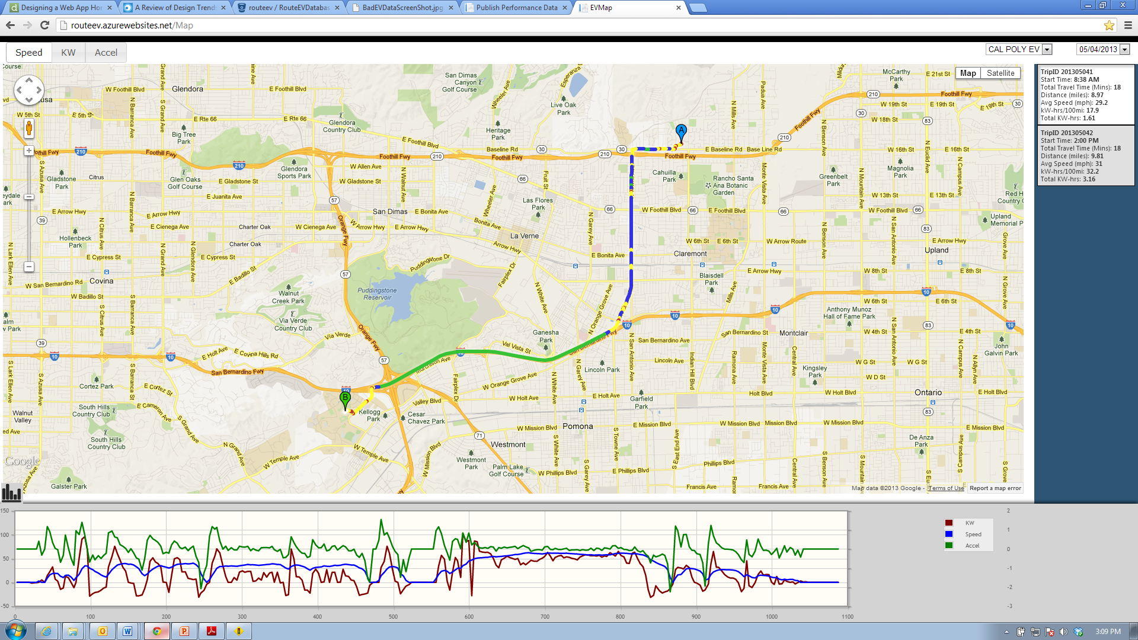
DATA (3)：Data Download
Home Data Products News About Us Contact Us
出现数据点的下来菜单；
同时运行直接在地图上点击数据点
同时提供时间的选择
Please select Data Location:
Beijing 03
Start Time:
8:00 AM
End Time:
11:00 AM

Slide 7
DATA (4)：Data Upload
Home Data Products News About Us Contact Us
提供直接在地图上点击添加数据采集点的功能

Slide 8
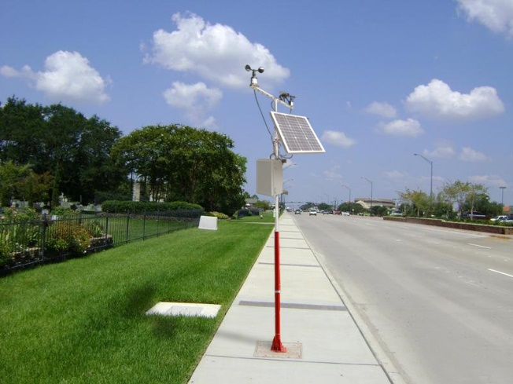
Products (1)
Home Data Products News About Us Contact Us
iEQBox: Intelligent Environmental Box
包涵一个下拉菜单“iEQBox”
点击下图进入下一页

Slide 9
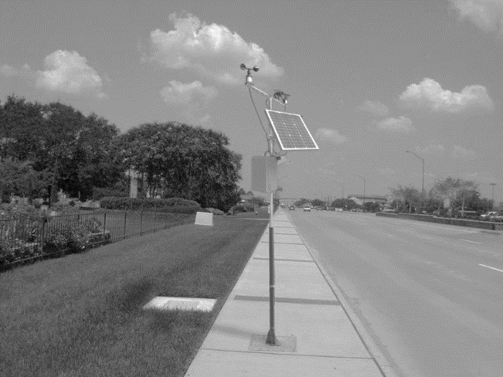
Products (2.1)
Home Data Products News About Us Contact Us
Concept Architecture Components Features Applications Tech. Specification
iEQBox is a smart all-in-one air quality monitoring device. The device integrates the state-of-the-art air quality and meteorological sensors into a portable, ready-to-mount, and cost-effective unit to measure air pollutants, including CO, CO2, O3, NO2, SO2, PM 1.0, PM2.5, and PM10.0, and meteorological data, such as wind direction, wind speed, temperature and relative humidity (RH). The device can be powered by either electric or solar power for the use in the field. The device is also equipped with GPS and cellular communication modules for recording device locations and wirelessly transmitting data in real time.

Slide 10
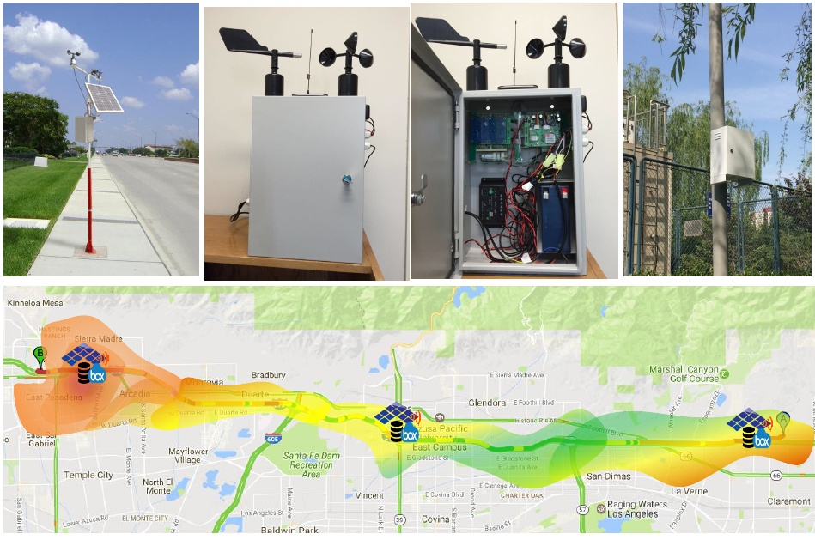
Products (2.2)
Home Data Products News About Us Contact Us
Concept Architecture Components Features Applications Tech. Specification
Compared to air quality monitoring stations, iEQBox is low-cost and portable but with accurate enough measurements of various pollutants. The low-cost and portable design allows large-scale installation to capture the spatial and temporal distribution of air pollutants in a large area. With various air pollutants and meteorological data continuously measured, iAQBox can be customized for many applications, such as analyzing health effects of air pollution and studying the impacts of traffic emission on air quality.

Slide 11
Products (3)
Home Data Products News About Us Contact Us
Concept Architecture Components Features Applications Tech. Specification

Slide 12
Products (4)
Home Data Products News About Us Contact Us
Concept Architecture Components Features Applications Tech. Specification

Slide 13
Products (4)
Home Data Products News About Us Contact Us
Concept Architecture Components Features Applications Tech. Specification
Easy installation: The device can be easily mounted to any existing traffic facilities such as signal lighting poles, beams, and callbox poles.
Real-time data transmission: The embedded cellular module allows the transmission of both air pollution and meteorological data to a central server in real time.
Portable use: The integrated GPS sensor provides the data collection location for measured air pollutant and meteorological data.
Low cost: Elegant integration of the system greatly lowers the overall cost.

Slide 14
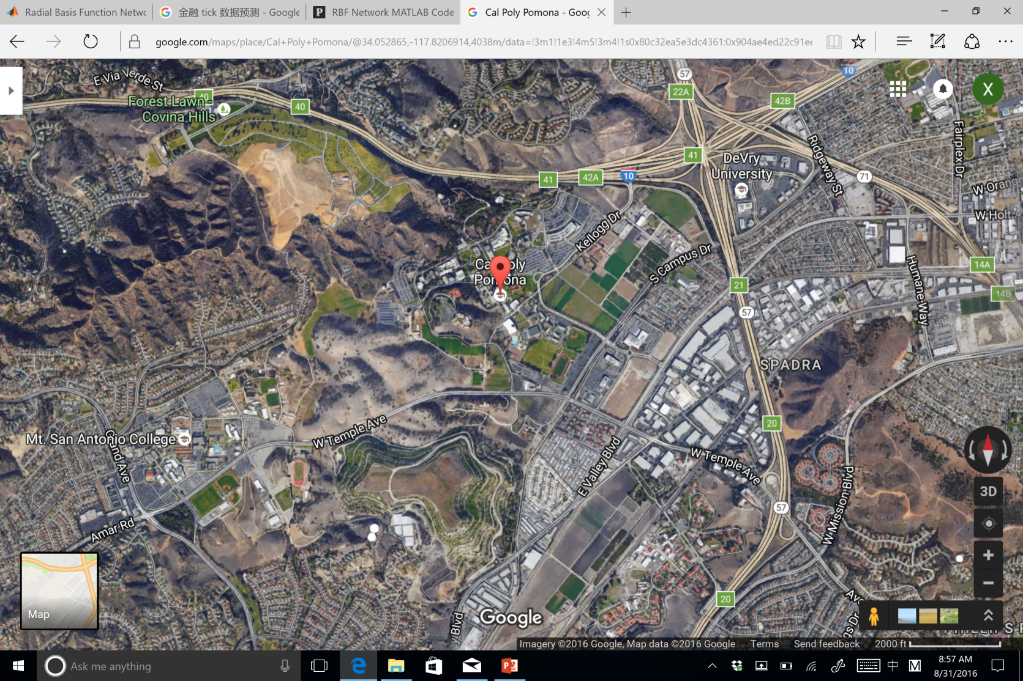
Products (5.1)
Home Data Products News About Us Contact Us
Concept Architecture Components Features Applications Tech. Specification
Los Angeles, CA, USA

Slide 15
Products (5.2)
Home Data Products News About Us Contact Us
Concept Architecture Components Features Applications Tech. Specification

Slide 16
Products (6)
Home Data Products News About Us Contact Us
Concept Architecture Components Features Applications Tech. Specification

Slide 17

News
Home Data Products News About Us Contact Us
EVOGLE 1.0 APP issued !!!
APP 二维码

Slide 18
About Us
Home Data Products News About Us Contact Us
Located in beautiful Los Angeles, CA, USA, EVOGLE, LLC is a high-tech environmental company. The company focuses on innovative high-technologies development on environmental monitoring, environment protection, and environment improvement. The company invented iEQBox: intelligent Environmental Quality Box, which is a state-of-the-art and state-of-the-practice product for air qualify monitoring, air big data application, and intelligent decisions for environment protection and improvement. The iEQBox has been applied in LA, CA, USA and Beijing, China.

Slide 19
Contact Us
Home Data Products News About Us Contact Us
Contact us at: evogle.com@gmail.com

